Slide 1

WEB BASED GAMES WITH TWO PLAYERS
(XOX)
Project Supervisor : Dr.R.M.Gomathi
Name of the Student : AMIRNENI KRISHNA TEJA
Register Number : 39120008

Slide 2
Presentation Outiline
Course Certificate
Introduction
Objectives
System Architecture/Ideation Map
System Requirements
Module Implementation
Project Screenshots
Results And Discussions
Conclusion & Future work
References

Slide 3
Course Certificate

Slide 4
Introduction
It is a well-known game as TIC TAC TOE.
Which we all played in our Child-hood using paper and pen.
In a brief,It is a puzzle with x & o’s.
We can design our puzzle by creating a 3X3 matrix.
And we will create two colors for two options (x&o) to have unique representation.
And the game starts now…

Slide 5
Objectives
The primary objective of the game is for players to position their marks so that they make a continuous line of three cells vertically, horizontally, or diagonally
The game is concluded when three x’s or o’s match in the series or else it will be tie.
The result screen then displays the winner and also shows option for restart.

Slide 6
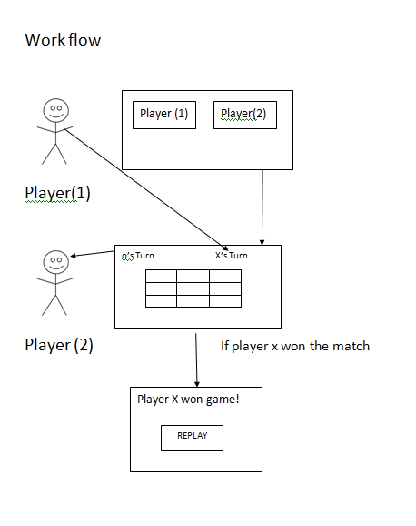
Ideation Map

Slide 7
Technologies Used
HTML
CSS
JavaScript
GitHub

Slide 8
Hardware And Software Requirements
4gb RAM,Operating System,Windows 10,
Intel i3,10 Generation, Visual Studio Code(optional)

Slide 9
Module Implementation
Game starts by clicking start the game by the user.
First x have to select a box in matrix.
Player-o gets chance after Player-x.

Slide 10
Module Implementation
Whenever player-x select a box in 3 X 3 matrix
Player o also get a chance to select a box on 3X 3 matrix other than selected one
Either player x or Player o makes a diagonolly or horizontal or vertically match the player will win or else the game will be draw

Slide 11
Controls
Player-x starts the game.
Click on box to mark x in the matrix.
Player o starts .
Click on box to mark o in the matrix.
When the x or o matches , the result is displayed on the result screen.
Click on reset to play again

Slide 12
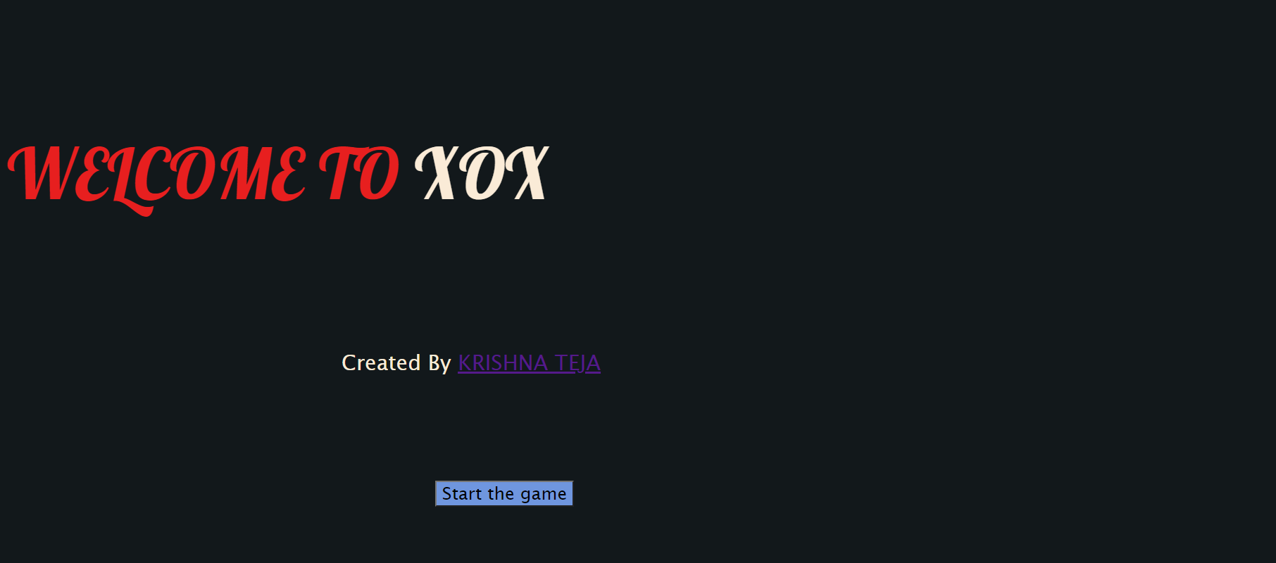
Project Screenshots
Welcome Screen

Slide 13
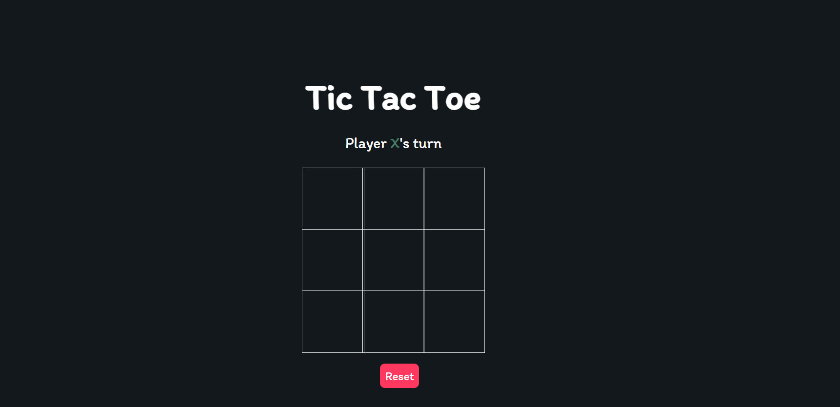
Result And Discussions
First phase

Slide 14
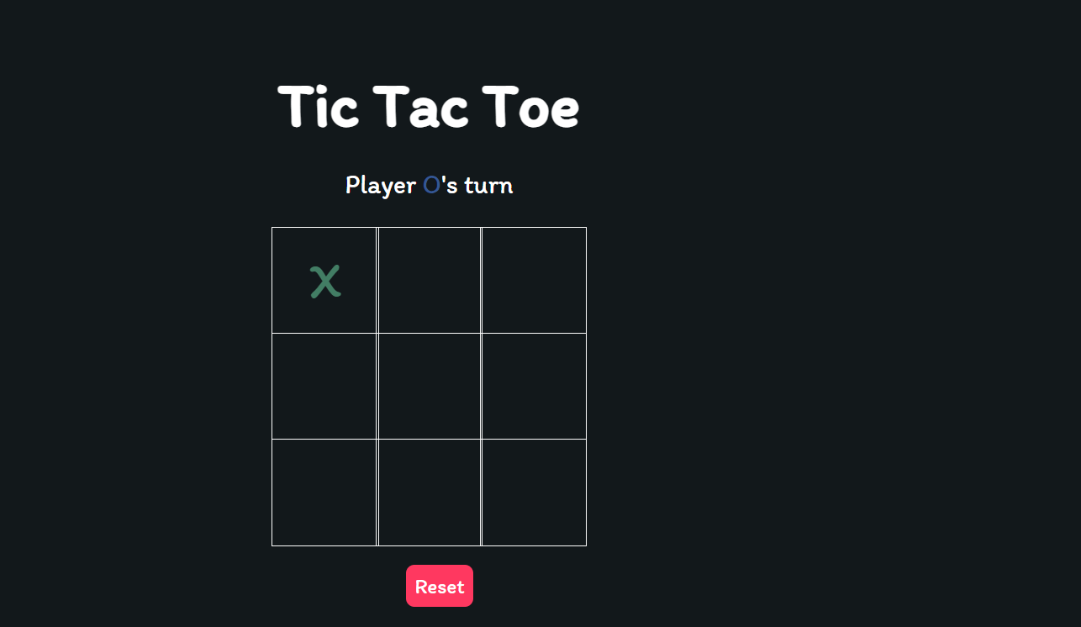
Result And Discussions
Second phase

Slide 15
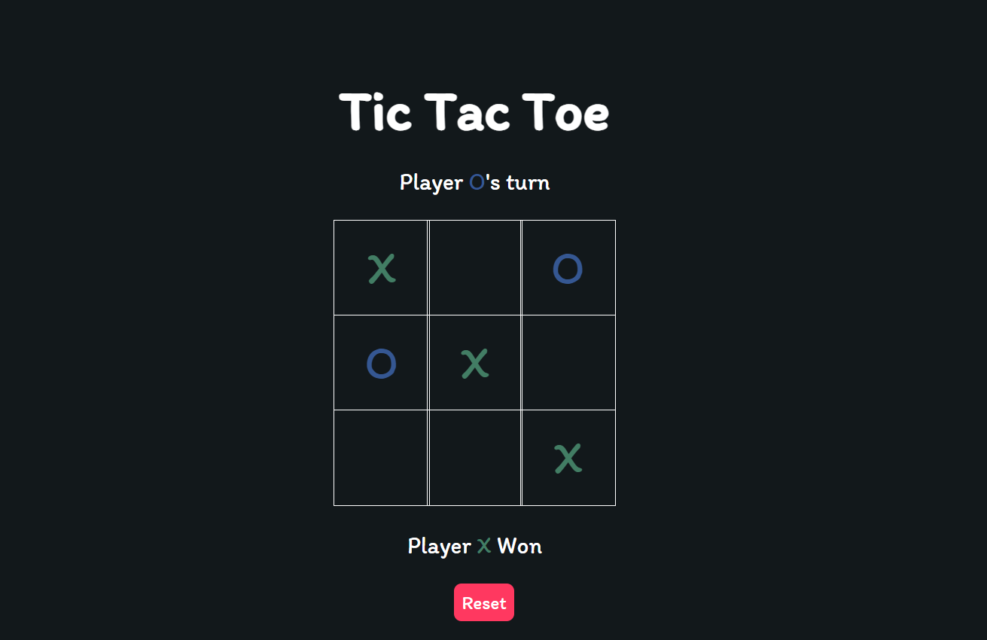
Result And Discussions
Final Phase

Slide 16
Conclusion
In the project two clients comes together to connect and plays the game.
The project can be taken a set forward by giving a options to play with bot and also accessible from two different systems.(My View).

Slide 17
References
HTML5 W3C Recommendation 28 October 2014 (@ http://www.w3.org/TR/html5).
W3School HTML/CSS Tutorials, References and Examples @ http://www.w3schools.com/.
https://developer.mozilla.org/en-US/docs/Web/JavaScript
https://github.com/Amirnenikrishnateja/XOX

